Slide 1




Introduction to jQuery
jQuery Library, Selectors, DOM Manipulation, Events
jQuery
SoftUni Team
Technical Trainers
Software University
http://softuni.bg

Slide 2

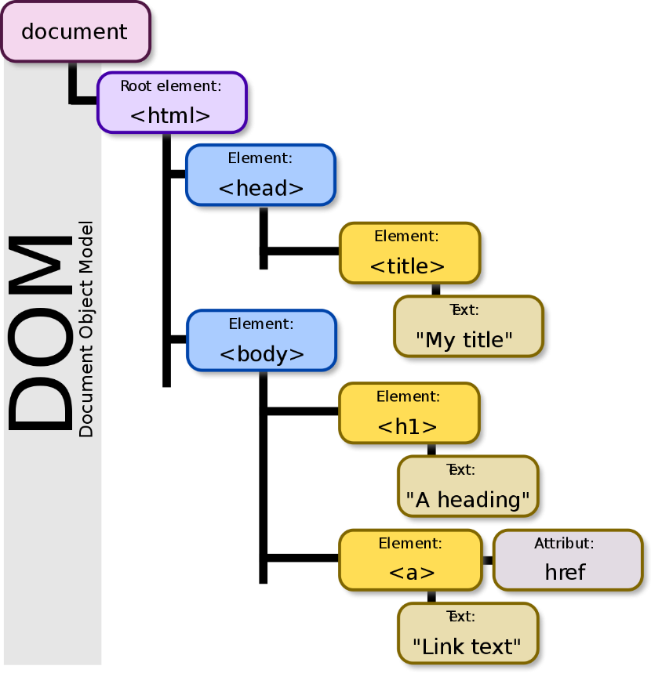
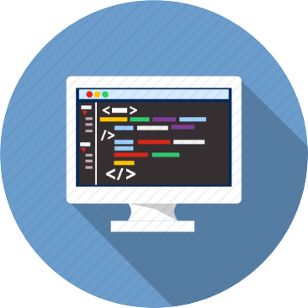
Table of Contents
jQuery Overview
jQuery Selectors
DOM Manipulation
Handling Events

Slide 3
Have a Question?
sli.do #front-end

Slide 4
What is jQuery?
jQuery is a cross-browser JavaScript library
Dramatically simplifies DOM manipulation
Free, open-source software: https://jquery.com
<script src="https://code.jquery.com/jquery-3.1.1.min.js"></script>
Load jQuery from its official CDN
$('li').css('background', '#DDD');
Change the CSS for all <li> tags

Slide 5
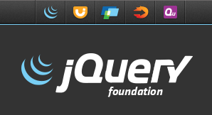
Why jQuery?
Very popular
60 000 000 sites use jQuery (75.8% of top 1 million sites)
http://trends.builtwith.com/javascript/jQuery
Easy to learn
Large community
Cross-browser support
Official web site: http://jquery.com

Slide 6
Selection with jQuery
jQuery selectors return a collection matched items
Even if there is only one item
http://learn.jquery.com/using-jquery-core/selecting-elements/
Selected elements can be processed as a group
$('div') // document.getElementsByTagName('div');
$('.menu-item') // document.getElementsByClassName('.menu-item');
$('#navigation') // document.getElementById('navigation');
$('ul.menu li') // document.querySelectorAll('ul.menu li');
$('div').css('background', 'blue'); // Make all DIVs blue

Slide 7
jQuery Selectors
DOM elements selection in jQuery is much like as in JavaScript
All selector
Class selector
Element selector
Id selector
Multi-selector
$('*') // Selects all elements
$('.class') // Selects all elements by class name
$('section') // Selects all elements by tag name
$('#id') // Selects a element by given id
$('selector1, selector2') // Combined selector

Slide 8
Filter Selectors in jQuery
$('li:even') // Even <li>
$('li:odd') // Odd <li>
$('li:first') // First <li>
$('li:last') // Last <li>
$('li:first-child') // Selects the first child of <li>
$('li:has(p)') // Selects all <li> holding <p> inside
$('li:contains("Sofia")') // Selects <li> holding given text
$('li:eq(2)') // Selects the third <li> element
$('li:not(:checked)') // Elements not matching the selector

Slide 9
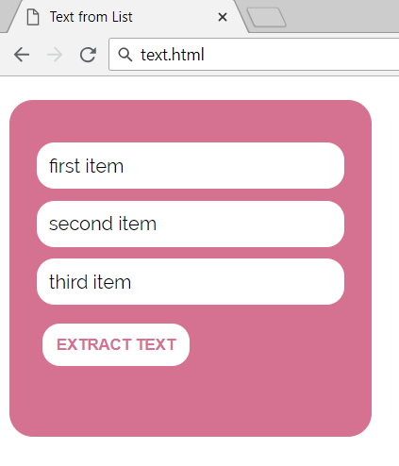
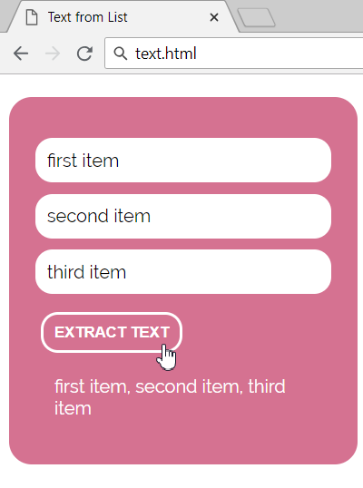
Problem: Text from List
An HTML page holds a list of text items + [Extract Text] button
Write a JS function to display all list items, separated by ","

Slide 10
Problem: Text from List – HTML
<ul id="items">
<li>first item</li>
<li>second item</li>
<li>third item</li>
</ul>
<button onclick="extractText()"> Extract Text</button>
<div id="result"></div>

Slide 11
Solution: Text from List
function extractText() {
let items = $("ul#items li")
.toArray()
.map(li => li.textContent)
.join(", ");
$("#result").text(items);
}
Check your solution here: https://judge.softuni.bg/Contests/1098

Slide 12
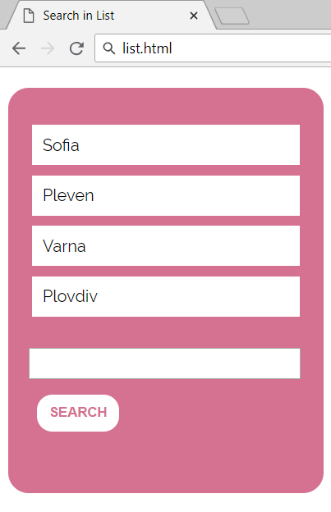
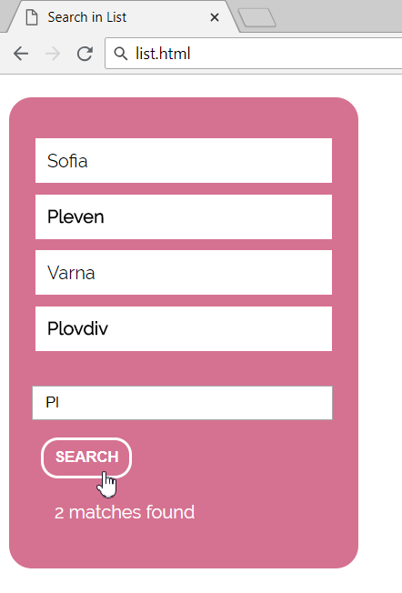
Problem: Search in List
A HTML page holds a list of towns + search box + [Search] button
Write a JS function to highlight all towns holding the search text

Slide 13
Problem: Search in List – HTML
<ul id="towns">
<li>Sofia</li>
<li>Pleven</li>
<li>Varna</li>
<li>Plovdiv</li>
</ul>
<input type="text" id="searchText"/>
<button onclick="search()">
Search
</button>
<div id="result"></div>

Slide 14
Solution: Search in List
function search() {
let searchText = $('#searchText').val();
let matches = 0;
$("#towns li").each((index, item) => {
if (item.textContent.includes(searchText)) {
$(item).css("font-weight", "bold");
matches++;
} else
$(item).css("font-weight", "");
});
$('#result').text(matches + " matches found.");
}
Check your solution here: https://judge.softuni.bg/Contests/1098

Slide 15

Altering the DOM with jQuery
Adding and Removing DOM Elements

Slide 16
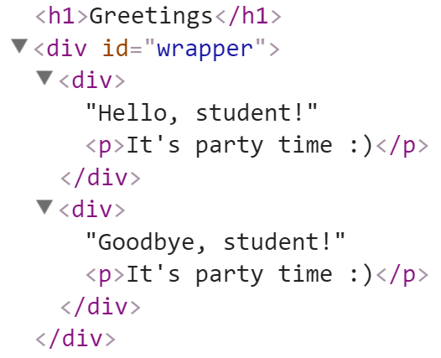
Adding Elements with jQuery
Select the parent element, then use:
append() / prepend()
appendTo() / prependTo()
<div id="wrapper">
<div>Hello, student!</div>
<div>Goodbye, student!</div>
</div>
$('#wrapper div').append("<p>It's party time :)</p>");
$('<h1>Greetings</h1>').prependTo('body');

Slide 17
Creating / Removing Elements
let div = $('<div>');
div.text('I am a new div.');
div.css('background', 'blue');
div.css('color', 'white');
$(document.body).append(div);
let paragraph = $('<p>Some text</p>');
paragraph.appendTo(div);
$('div').remove();

Slide 18
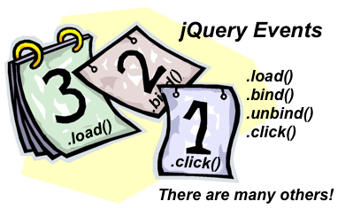
jQuery Events
Handling Events with Ease

Slide 19
jQuery Events: Attach / Remove
Attaching events on certain elements
$('a.button').on('click', buttonClicked);
function buttonClicked() {
$('.selected').removeClass('selected');
$(this).addClass('selected');
// "this" is the event source (the hyperlink clicked)
}
Removing event handler from certain elements
$('a.button').off('click', buttonClicked);

Slide 20
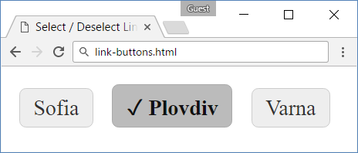
Problem: Link Buttons – HTML
<head>
<link rel="stylesheet" href="link-buttons.css"/>
<script src="jquery-3.1.1.min.js"></script>
<script src="link-buttons.js"></script>
</head>
<body onload="attachEvents()">
<a class="button">Sofia</a>
<a class="button">Plovdiv</a>
<a class="button">Varna</a>
</body>

Slide 21
Problem: Link Buttons – CSS
link-buttons.css
a.button {
border: 1px solid #CCC;
background: #EEE;
padding: 5px 10px;
border-radius: 5px;
color: #333;
text-decoration: none;
display: inline-block;
margin: 5px;
}
a.button.selected {
color: #111;
font-weight: bold;
border: 1px solid #AAA;
background: #BBB;
}
a.button.selected::before {
content: "\2713\20\20";
}
a:hover {cursor: pointer;}

Slide 22
Solution: Link Buttons – JavaScript
link-buttons.js
function attachEvents() {
$('a.button').on('click', buttonClicked);
function buttonClicked() {
$('.selected').removeClass('selected');
$(this).addClass('selected');
// "this" is the event source (the hyperlink clicked)
}
}

Slide 23
jQuery Events: Multiple
Handling events on multiple elements
Add a handler on the parent element
For more events info visit MDN Events
function onListItemClick() {
$('.selected').removeClass('selected');
$(this).addClass('selected');}
$('ul').on('click', 'li', onListItemClick);

Slide 24
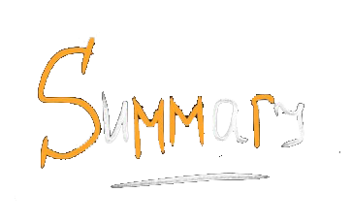

Summary
Summary
jQuery is very powerful on DOM manipulation
Very popular library, run on 60 000 000 sites
Select + edit DOM elements:
Create elements:
Handle events:
$('p.red').css('background', 'blue');
$('<h1>Hello</h1>').appendTo('body');
$('#items').click(function() { … });

Slide 25







JS for Front-end – Introduction to jQuery
https://softuni.bg/courses/javascript-for-front-end

Slide 26






SoftUni Diamond Partners

Slide 27






SoftUni Diamond Partners

Slide 28
License
This course (slides, examples, demos, videos, homework, etc.) is licensed under the "Creative Commons Attribution-NonCommercial-ShareAlike 4.0 International" license

Slide 29





Trainings @ Software University (SoftUni)
Software University – High-Quality Education, Profession and Job for Software Developers
softuni.bg
Software University Foundation
http://softuni.foundation/
Software University @ Facebook
facebook.com/SoftwareUniversity
Software University Forums
forum.softuni.bg

